Slide 1
LEARNOUS CASE STUDY CHALLENGE
2021
THE ASPIRANTS
AKASH GUPTA
8918843383
guptaakash1778@gmail.com
DEVESH SINHA
9475398602
deveshsinha01@gmail.com

Slide 2
01 Introduction
02 Mission
03 Market Research
04 Competitors
05 Business Value Proposition
06 Program Plan
07 Operations/Delivery Framework
08 Go To Market Strategy
09 Team Structure
10 Revenue Stream Analysis
11 Cost –Benefit Analysis
12 Ramp Up plan
CONTENTS

Slide 3



Educate yourself for Life
XYZ is a holistic life-skill educating platform for students, making them future ready and giving them an edge beyond academics.
We offer extracurricular courses online designed by Domain experts along with engaging celebrity Videos, for children between 8 and 18 years of age.
We are working together on a vision to make our children future-ready and help them realize their true potential.

Slide 4
MISSION
SHORT-TERM
LONG-TERM
Create awareness, Gain attention
Educate parents about the role of extracurriculars in a child's holistic development
Facilitate app downloads and Website SignUps for data acquisition.
Pitch for Direct Sales, Upselling and Cross Selling.
Increase Brand penetration through School and Society Campaigns,
Build a strong XYZ community for word of mouth promotions
Boost revenues
Establish XYZ as an integral part of a student's education.

Slide 5

Market research: primary
Target: Parents having children in the age group 8-18 years
Sample Size: 97
Key Findings:
100% Parents acknowledged extracurricular activities as vital.
77% of the respondents stated the need of a dedicated extracurricular platform.

Slide 6
Market research: secondary
Investors bet big on EdTech startups that bring extracurriculars online.
Huge Markets for ECAs across the world.
Percentage of students in 8-18 years involved in ECAs in some form-
Russia: 80% - 94%
Sweden: 75%
Australia up to 91%
United States: 83%
      India: 72%
      No dedicated ECAs platforms in India, which brings in huge market opportunities for new entrants.
Middle Childhood (6-18) Years is the gateway between childhood and early adolescence and a time during which developmental trajectories are shaped.
Extracurricular engagement was positively related to academic performance, motivation, social skills, and educational resilience, and negatively related to behavioural problems, and school dropout

Slide 7

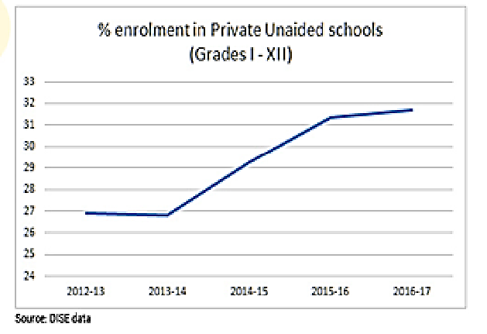
India- an untapped market
“The market size for co-curricular and extra-curricular learning is estimated to be $10 billion in India alone and around $200 billion globally.” (Source: Live Mint)
25 Crore students (8-18yrs)
* Figures are in millions
Share of Private Schools on rise as parents believe text book education is not enough. Private Schools emphasizes more on ECAs.
Notes:
Bar chart

Slide 8

















Direct Competitors
Potential competitors
Competitors
Partial Competitors
NO COMPETITOR WITH MATCHING PRODUCT PORTFOLIO!!

Slide 9




Business Value proposition
We make our students world ready with:
Engaging Celebrity Pedagogy for Building resilient interest.
Learn from the best of the domain Experts with 3 incremental levels of learning.
Personalized Support Guide to walk you through the Course.
Best Practice content which lets you manifests practically what you learnt theoretically.
Notes:
icons

Slide 10



















Program plan
Craft Activities
Painting
Decoration
Embroidery
Weaving
Cartooning
Literary Activities
Poem
Story writing
Acting/Drama
Creative Writing
More Genres Coming Soon…
Miscellaneous
Yoga
Dance
Music
Cooking
Photography
Leisure
Activities
Coin Collection
Stamp Collection
Rare Stones
Gardening
Toy Making

Slide 11




App Modes
Basic
Advanced
Practice
Introductory Videos
Journey of Celebrities
Learn how to Learn
Increase level of expertise
Detailed Expert Lectures
Animated fun Videos
Real Life Applications
Unlocks once Basic Mode complete
Assignments/Tasks with 3 Levels
Tasks by Celebrities
Know & practice the Current Trends
*Each ECA available in all 3 modes.
10mins Quiz Challenge
Connect & Compete with Peers
Choose your own genre
Anytime
Personalized Guide
Provides Weekly routines, Interacts with Parents and Students on Progress Reports as required.
News customised for each Age Group
10 min Video format
Text Format
Mentor support available through both call and chat.

Slide 12
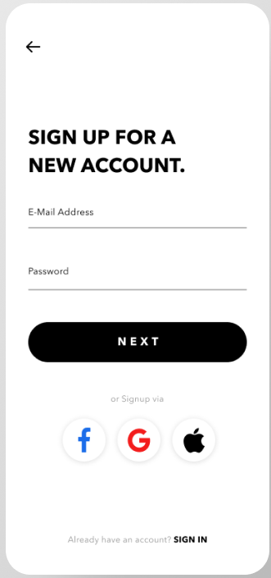


Our plans
Basic
Premium
Download the XYZ app now.
1 Genre Full Access.
Rs. 3,000/- Per Year
3 Genres Full Access.
Rs. 3,600/- Per Year
Pro
5 Genres Full Access.
Rs. 5,000/- Per Year

Slide 13
Operations framework
Content Team
Chalk out the best celebrities and experts in terms of popularity and relevance in each domain.
Create a structured course in collaboration with expert and celebrity for each domain
Update the Content Based on Views and Reviews by enrolled Students and insights from Product Experts.
Update Daily News in Video and Text Formats sorted by relevance for students of different Age Groups.
Update Quiz questions regularly for the Quizzo feature on the App.

Slide 14
Operations framework
Sales Team
Data Acquisition & Lead Generation through App downloads and Website Signups.
Dedicated Sales Team will use contact details to pitch Customers for an Online Demo on any one subject of Interest.
Online Sales meeting for pitching the product.
Dedicated Inside Sales team to address inbound product queries on website. They will provide Demo and then Sales Pitch.
Inside Sales team would Collect referrals Leads from Product Experts and pitch them.

Slide 15
Operations framework
Product Experts
Team of Product Experts to be Trained about all the features of the App, Basic level knowledge to be imparted on each of the ECA Genres.
All Enrolled Students to be Distributed among Product Experts with Dashboards keeping track on activities of the students on the App.
Product Experts will share personalized weekly routines made based on our content and availability of the student’s time.
Product Experts will share Auto-Generated monthly Activity & Performance reports with Parents and Students.
Product Experts will generate leads through referrals from happy Customers and provide incentives to existing customers in form of discounts/cashbacks on renewals.

Slide 16
Operations framework
Organize Seminars/Webinars to create awareness, need generation, data acquisition.
Community Team
Regular Managing of the Community building Platform which would include posting engaging content and Display of creative works by existing students to encourage others.
Address any kind of doubts and queries on the platform.
Conduct Surveys and Reviews to gain insights on the relevance of Content.
Arrange Excursions needed for ECAs (Part of the Ramp-Up Plan)

Slide 17





Go to Market Strategy
Launch
Pan India launch of App and Website
School/Society Campaigns
Mass and Targeted media
Maharashtra, as in the initial target state for school/society campaigns.
Size: 2,28,22,462, Age group: 8-18
Advertising Outbound- TV, Print Medium
Advertising Inbound- Digital, search
Product Placements
Public Relations
Personal and Interpersonal Means
Salesforce, Word Of Mouth, Referrals
Schools Campaigns, Society Campaigns

Slide 18









Go to Market Strategy
Mass and Targeted Media
Digital Advertisement
Television
Reach: 26.5 Crores
Views: 4 Crores
Ad Type: Skippable Video(only after 20 secs)
Reach: 32 Crores
Ad Units – 1 Crore
Ad Type- CPC Banners
Ad on 4 most viewed channels
Ad Freq- 6 times/day
Ad Timings- 18:00 – 24:00
Duration – 180 days
Newspaper
Reach: 23.5 Crores
Ad Units: 3 Crore CPM PreRoll Units
Ad Type: 10 sec Video Ad
Reach: 8,30,000
Ad Type : Display Ad
Ad Size: Half Page(825 sqcm)
Ad Frequency- Every Sunday

Slide 19






Go to Market Strategy
Google Search
Website Development:
Website to be developed so as it appears in maximum searches.
Content Development for SEO:
Rich Content Marketing for maximum appearances in search.
Sponsorship:
Targeted School Events.
Events with relevant Footfalls
School Campaign
Organize Workshops on ECAs
Organize Quiz Competitions
Conduct Seminars on ECAs
10 Lakh clicks
Google Display Ad
20 Lakhs CPC Units

Slide 20









Go to Market Strategy
Data Acquisition
Sales team
School Campaign
Society Campaign
App Downloads, Website Signups
Workshops, Seminars
Dedicated Sales Team will use contact details to pitch Customers for an Online Demo on any one subject of Interest followed by Sales Pitch.
Identify Resourceful Customers to pitch in bigger deals
Target- 28,000 Schools in Maharashtra;10 Schools to be Targeted Monthly
Awareness Programs through Seminars for students along with parents
Pitch Sales at discounted Prices for School Students
Conduct Awareness Programs along with Activities
Pitch Sales at discounted Prices for Society Kids

Slide 21
Team structure
CEO
CMO
CFO
Tech Head
Content Head
HR Head
Event/Community Executive
Event Manager
Business Development Manager
Marketing Manager
Sales Executive
Inside Sales Executive
Outbound Executive
Inbound Executive
Accounts/Billing Executive
Finance Executive
Outsourced Team
Tech Support Team
Senior Support Manager
Content Development Manager
Regional Team Lead
Product Expert
Content Executive
HR Executive
Admin Executive

Slide 22
Revenue stream analysis
Source | Targeted Reach | Conversion Rate | Website Visits
News Paper Ad | 8.30 Lakhs | 0.51% | 4150
Television Ad | 18.5 Cr | 0.77% | 1424500
YouTube Ad | 4 Cr | 0.51% | 204000
Facebook Ad | 1 Cr | 9.21% | 921000
Hotstar Ad | 3Cr | 7% | 2100000
Google Display Network | 20 Lakh | 0.57% | 11400
Total Website Visits |  | 46,65,050
Website Signups/App Downloads | 6% | 2,79,903
Total Direct Sales | 10% | 27990
Referrals by existing customers | 20% | 5,998
Sales from referrals | 50% | 2,800
Total Sales |  | 30790
Average Price* |  | 3600
Total Estimated Revenue in Y1 |  | 11,08,44,000
* Product price is assumed to be the average of Basic, Premium and Pro plans.
Note: All conversions are calculated based on industry standards and marketing strategies adopted.

Slide 23
Cost Benefit Analysis
Fixed Costs
App & Website Development | 14,00,000
IT Infrastructure | 20,00,000
Operations Software | 1,00,000
Cloud Hosting | 30,00,000
Celebrity Engagements | 48,00,000
Total Fixed Costs | 1,13,00,000
Employee Costs | 2,13,00,000
Marketing Expenditure
Mass & Target Media
Newspapers | 4,56,60,000
TV | 13,08,00,000
Digital Marketing
YouTube | 1,41,60,000
Facebook | 4,72,00,000
Disney+Hotstar | 31,86,000
Google(SEM) | 2,36,00,000
Google Display Network | 1,18,00,000
Total Advertising Costs | 17,96,46,000
Total Costs | 21,22,46,000
 | Year 1 | Year 2 | Year 3
Revenue | 11,08,44,000 | 16,62,58,800 | 23,27,65,200
Cost | 21,22,46,000 | 22,25,20,600 | 23,14,21,424
Note:
App , Website , IT Infra, Cloud Maintenance Cost Taken as 10%.
Employee Cost to increase by 10% YoY.
Marketing Expenditure to increase by 10% YoY.

Slide 24




Ramp-up plan
Marketing Campaign Expansion
Advertisement to be expanded to 2 more Newspapers as per popularity
4 more channels to be included as advertisement partners
3 more Digital Ad partners to be Selected.(JioSaavn, Instagram, Truecaller)
Product Portfolio Expansion
Inclusion of more fields into product portfolio as per students demand.
Once a sizeable community is built, Excursion and trips to be included as ECAs
School/Society Campaign
Target- 28,000 Schools in Maharashtra
10 Schools to be Targeted Monthly
Conducting of Workshops, Seminars, Quizzes for data acquisition and sales.
Target Eligible Societies and conduct workshops/activities for students and parents to create awareness and encourage them to Signup to XYZ.
Views to be expanded from 4 Crores to 8 Crores
5Crore additional CPM Pre-Roll Units to be used for Ads
5 Crore additional CPC Banners to be used for Ads.
Google Search-20 Lakh addition clicks
Display Network- 40 Lakh additional CPC Units

Slide 25
Thank you!

